Slide 1
CYBERNAYA

Slide 2
TOPIC
ANDROID SCAM
By – Raushan kumar

Slide 3
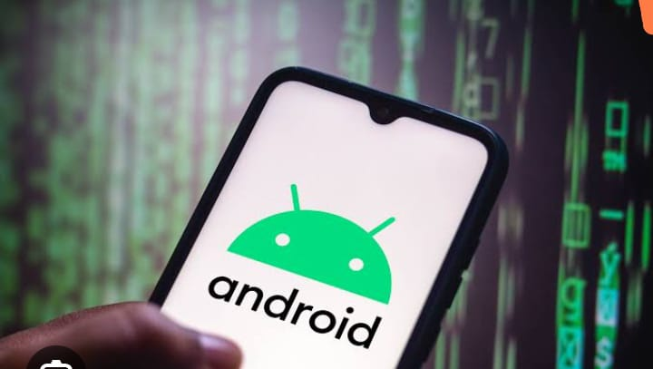
I have created a system in android with the help of which android will not receive fake OTP .
. If someone asks for an OTP , he will not receive the OTP and will alert you that your mobile
Is about to be hacked. The name of whoever is hacking will be known . Please careful.

Slide 4
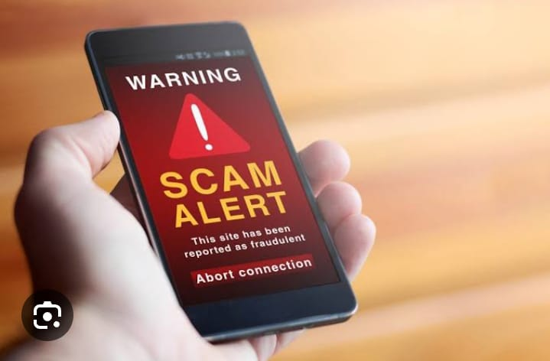
This scam system will work in all Android systems which will be very useful in human life
and any mobile will be protected from getting hacked. With its help any system will be protected from being hacked. Our life will be very successful.

Slide 5
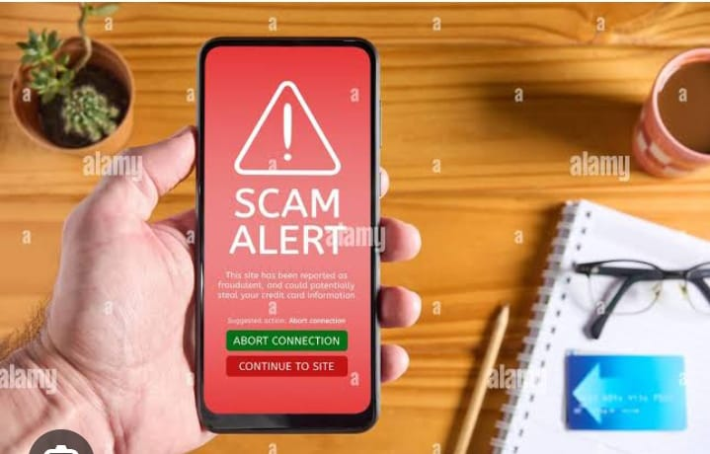
If this system is created in Android then a person can do any work easily in Android and a person cannot be afraid of doing any work or it is good to be careful in doing it very carefully in life.

Slide 6

If this system is created in Android, then I can easily use any app and can overcome
the problem of getting hacked. By doing any work, any fear will go away and we can
do any work with easy or will be very successful in life.

Slide 7
With the help of this system, you can keep of any data in Android. We will be no
careful here to save any data in life or any data can be hacked. There will be no
fear of this.

Slide 8
After this system is created in Android, there will be data security and there
will be no fear of any data being linked. With its help, we can keep any
data in the mobile and any data of yours.

Slide 9
Its biggest feature is that it will not even receive the OTP of the hacked system
And will alert you to be careful. Such scanning is being done on your mobile
Through your android system.

Slide 10
After making this system, you will be able to know which things can be hacked
here and which things are being hacked more. You will come to know these
things. We will make you cautious about these things.

Slide 11
This system will help in capturing a lot of apps and a lot of data created in life
And this system will be very successful in life.

Slide 12
THANK YOU

